Slide 1
Covid-19 Prediction Using Machine Learning
A project by aspiring Data Analysts...
Boomika R Haripriya Praveen Kumar Surendranathan

Slide 2
Introduction Abstract Process / Flow
Attribute Information
Problem Statement Glimpse of the Data Problem Solution Data Description EDA
Machine Learning Alogrithms Accuracy Comparison
Thank You
Agenda

Slide 3
Abstract
Coronavirus disease (COVID-19) is an infectious disease caused by a newly discovered coronavirus. Most people infected with COVID-19 virus will experience mild to moderate respiratory illness and recover without requiring special treatment. Older people, and those with underlying medical problems like cardiovascular disease, diabetes, chronic respiratory disease, and cancer are more likely to develop serious illness.
During the entire course of the pandemic, one of the main problems that healthcare providers have faced is the shortage of medical resources and a proper plan to efficiently distribute them. In these tough times, being able to predict what kind of resource an individual might require at the time of being tested positive or even before that will be of immense help to the authorities as they would be able to procure and arrange for the resources necessary to save the life of that patient.
Back to Agenda Page

Slide 4

Introduction
COVID-19 (coronavirus disease 2019) is a disease caused by a virus named SARS-CoV-2. It can be very contagious and spreads quickly. Over one million people have died from COVID-19 in the United States.
COVID-19 most often causes respiratory symptoms that can feel much like a cold, the flu, or pneumonia. COVID-19 may attack more than your lungs and respiratory system. Other parts of your body may also be affected by the disease.
Most people with COVID-19 have mild symptoms, but some people become severely ill.Some people including those with minor or no symptoms will develop Post-COVID Conditions – also called “Long COVID.”
Back to Agenda Page

Slide 5
Process / Flow
DATA
Back to Agenda Page
Data Preprocessing
Exploratory Data Analysis (EDA)
Split Data
Training Data
Test Data
Model Training
Model Evaluation (Best Model)

Slide 6
Attribute Information:-
The dataset consists of data of anonymous covid patients from mexico. It has their medical history and medical status at that particular time.In the Boolean features, 1 means "yes" and 2 means "no". values as 97 and 99 are missing data. The respective columns mean:
sex: 1 for female and 2 for male.
age: of the patient.
classification: covid test findings. Values 1-3 mean that the patient was diagnosed with covid in different degrees. 4 or higher means that the patient is not a carrier of covid or that the test is inconclusive.
patient type: type of care the patient received in the unit. 1 for returned home and 2 for hospitalization.
pneumonia: whether the patient already have air sacs inflammation or not.
pregnancy: whether the patient is pregnant or not.
diabetes: whether the patient has diabetes or not.
copd: Indicates whether the patient has Chronic obstructive pulmonary disease or not.
asthma: whether the patient has asthma or not.
inmsupr: whether the patient is immunosuppressed or not.
Back to Agenda Page

Slide 7
Attribute Information:-
hypertension: whether the patient has hypertension or not.
cardiovascular: whether the patient has heart or blood vessels related disease.
renal chronic: whether the patient has chronic renal disease or not.
other disease: whether the patient has other disease or not.
obesity: whether the patient is obese or not.
tobacco: whether the patient is a tobacco user.
usmr: Indicates whether the patient treated medical units of the first, second or third level.
medical unit: type of institution of the National Health System that provided the care.
intubed: whether the patient was connected to the ventilator.
icu: Indicates whether the patient had been admitted to an Intensive Care Unit.
date died: If the patient died indicate the date of death, and 9999-99-99 otherwise.
Back to Agenda Page

Slide 8
Problem Statement
The dataset was provided by the Mexican government). This dataset contains an enormous number of anonymized patient-related information including pre-conditions. The raw dataset consists of 21 unique features and 1,048,576 unique patients.
The main goal of this project is to build a machine learning model that, given a Covid-19 patient's current symptom, status, and medical history, will predict whether the patient is in death or not.

Slide 9
Glimpse of the Data
USMER | MEDICAL_UNIT | SEX | PATIENT_TYPE | DATE_DIED | INTUBED | PNEUMONIA | AGE | PREGNANT | DIABETES | ... | ASTHMA | INMSUPR | HIPERTENSION | OTHER_DISEASE | CARDIOVASCULAR | OBESITY | RENAL_CHRONIC | TOBACCO | CLASIFFICATION_FINAL | ICU
0 | 2 | 1 | 1 | 1 | 03/05/2020 | 97 | 1 | 65 | 2 | 2 | ... | 2 | 2 | 1 | 2 | 2 | 2 | 2 | 2 | 3 | 97
1 | 2 | 1 | 2 | 1 | 03/06/2020 | 97 | 1 | 72 | 97 | 2 | ... | 2 | 2 | 1 | 2 | 2 | 1 | 1 | 2 | 5 | 97
2 | 2 | 1 | 2 | 2 | 09/06/2020 | 1 | 2 | 55 | 97 | 1 | ... | 2 | 2 | 2 | 2 | 2 | 2 | 2 | 2 | 3 | 2
3 | 2 | 1 | 1 | 1 | 12/06/2020 | 97 | 2 | 53 | 2 | 2 | ... | 2 | 2 | 2 | 2 | 2 | 2 | 2 | 2 | 7 | 97
4 | 2 | 1 | 2 | 1 | 21/06/2020 | 97 | 2 | 68 | 97 | 1 | ... | 2 | 2 | 1 | 2 | 2 | 2 | 2 | 2 | 3 | 97

Slide 10
Problem Solution
Machine Learning Algorithms
In this project our main aim is to bridge the gap by following a systematic analysis of the various patient records and their health history for the purpose of covid-19 prediction.
Here we have performed various machine learning algorithms such as K- Nearest (KNN), Logistic Regression, Random Forest, and Decision Tree to make the prediction of the covid-19.

Slide 11
Data Description
USMER | MEDICAL_UNIT | SEX | PATIENT_TYPE | INTUBED | PNEUMONIA | AGE | PREGNANT | DIABETES | COPD | ASTHMA | INMSUPR | HIPERTENSION | OTHER_DISEASE | CARDIOVASCULAR | OBESITY | RENAL_CHRONIC | TOBACCO | CLASIFFICATION_FINAL | ICU
count | 1.048575e+06 | 1.048575e+06 | 1.048575e+06 | 1.048575e+06 | 1.048575e+06 | 1.048575e+06 | 1.048575e+06 | 1.048575e+06 | 1.048575e+06 | 1.048575e+06 | 1.048575e+06 | 1.048575e+06 | 1.048575e+06 | 1.048575e+06 | 1.048575e+06 | 1.048575e+06 | 1.048575e+06 | 1.048575e+06 | 1.048575e+06 | 1.048575e+06
mean | 1.632194e+00 | 8.980565e+00 | 1.499259e+00 | 1.190765e+00 | 7.952288e+01 | 3.346831e+00 | 4.179410e+01 | 4.976558e+01 | 2.186404e+00 | 2.260569e+00 | 2.242626e+00 | 2.298132e+00 | 2.128989e+00 | 2.435143e+00 | 2.261810e+00 | 2.125176e+00 | 2.257180e+00 | 2.214333e+00 | 5.305653e+00 | 7.955397e+01
std | 4.822084e-01 | 3.723278e+00 | 4.999997e-01 | 3.929041e-01 | 3.686889e+01 | 1.191288e+01 | 1.690739e+01 | 4.751073e+01 | 5.424242e+00 | 5.132258e+00 | 5.114089e+00 | 5.462843e+00 | 5.236397e+00 | 6.646676e+00 | 5.194850e+00 | 5.175445e+00 | 5.135354e+00 | 5.323097e+00 | 1.881165e+00 | 3.682307e+01
min | 1.000000e+00 | 1.000000e+00 | 1.000000e+00 | 1.000000e+00 | 1.000000e+00 | 1.000000e+00 | 0.000000e+00 | 1.000000e+00 | 1.000000e+00 | 1.000000e+00 | 1.000000e+00 | 1.000000e+00 | 1.000000e+00 | 1.000000e+00 | 1.000000e+00 | 1.000000e+00 | 1.000000e+00 | 1.000000e+00 | 1.000000e+00 | 1.000000e+00
25% | 1.000000e+00 | 4.000000e+00 | 1.000000e+00 | 1.000000e+00 | 9.700000e+01 | 2.000000e+00 | 3.000000e+01 | 2.000000e+00 | 2.000000e+00 | 2.000000e+00 | 2.000000e+00 | 2.000000e+00 | 2.000000e+00 | 2.000000e+00 | 2.000000e+00 | 2.000000e+00 | 2.000000e+00 | 2.000000e+00 | 3.000000e+00 | 9.700000e+01
50% | 2.000000e+00 | 1.200000e+01 | 1.000000e+00 | 1.000000e+00 | 9.700000e+01 | 2.000000e+00 | 4.000000e+01 | 9.700000e+01 | 2.000000e+00 | 2.000000e+00 | 2.000000e+00 | 2.000000e+00 | 2.000000e+00 | 2.000000e+00 | 2.000000e+00 | 2.000000e+00 | 2.000000e+00 | 2.000000e+00 | 6.000000e+00 | 9.700000e+01
75% | 2.000000e+00 | 1.200000e+01 | 2.000000e+00 | 1.000000e+00 | 9.700000e+01 | 2.000000e+00 | 5.300000e+01 | 9.700000e+01 | 2.000000e+00 | 2.000000e+00 | 2.000000e+00 | 2.000000e+00 | 2.000000e+00 | 2.000000e+00 | 2.000000e+00 | 2.000000e+00 | 2.000000e+00 | 2.000000e+00 | 7.000000e+00 | 9.700000e+01
max | 2.000000e+00 | 1.300000e+01 | 2.000000e+00 | 2.000000e+00 | 9.900000e+01 | 9.900000e+01 | 1.210000e+02 | 9.800000e+01 | 9.800000e+01 | 9.800000e+01 | 9.800000e+01 | 9.800000e+01 | 9.800000e+01 | 9.800000e+01 | 9.800000e+01 | 9.800000e+01 | 9.800000e+01 | 9.800000e+01 | 7.000000e+00 | 9.900000e+01
The data set consists of 5110 columns and 12 rows.

Slide 12
EDA-Exploratory Data Analysis
Exploratory data analysis (EDA) is used by data scientists to analyze and investigate data sets and summarize their main characteristics, often employing data visualization methods. It helps determine how best to manipulate data sources to get the answers you need, making it easier for data scientists to discover patterns, spot anomalies, test a hypothesis, or check assumptions.
EDA is primarily used to see what data can reveal beyond the formal modeling or hypothesis testing task and provides a better understanding of data set variables and the relationships between them. It can also help determine if the statistical techniques you are considering for data analysis are appropriate.

Slide 13
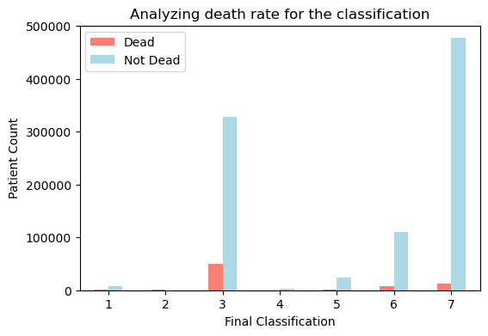
Analysis death rate for the classification
By using matplotlib

Slide 14
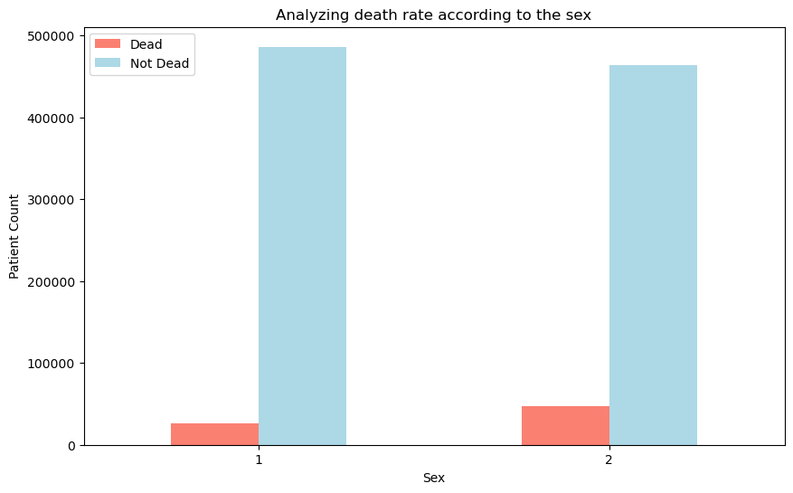
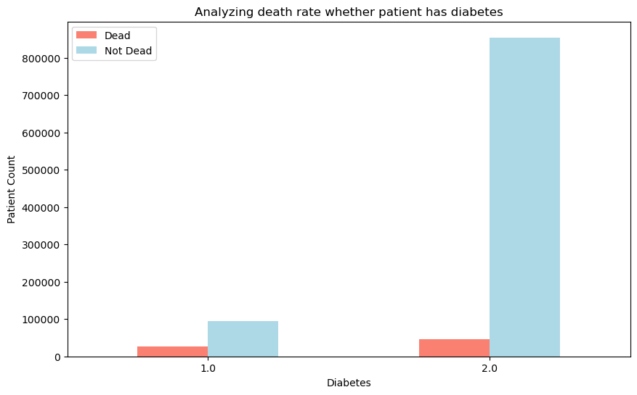
Conditional variables

Slide 15
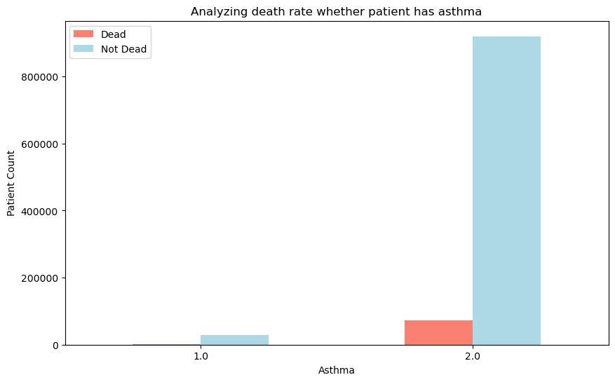
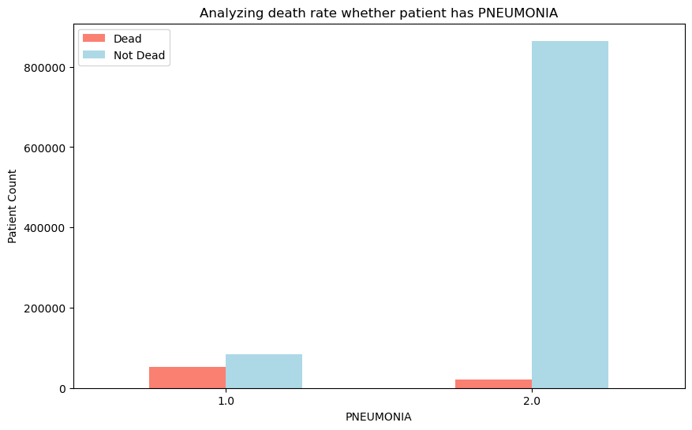
Continuous variable

Slide 16
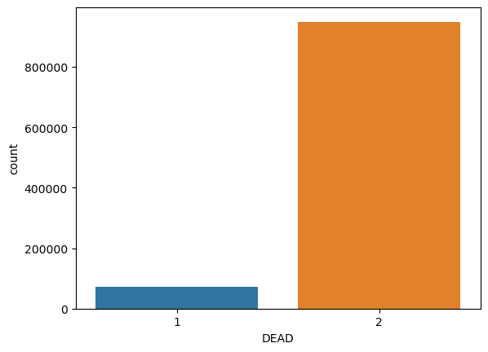
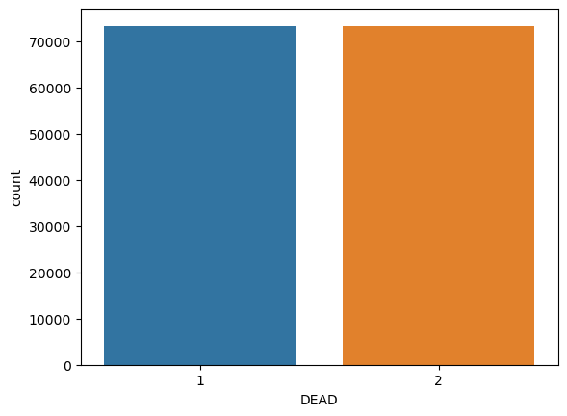
Target variable
Imbalance target variable Balance target variable

Slide 17

Machine Learning Algorithms
Machine learning can accelerate this process with the help of decision-making algorithms. It can categorize the incoming data, recognize patterns and translate the data into insights helpful for better decision making.

Slide 18
DECISION TREE
A decision tree is a type of supervised machine learning used to categorize or make predictions based on how a previous set of questions were answered.
The model is a form of supervised learning, meaning that the model is trained and tested on a set of data that contains the desired categorization.
The decision tree may not always provide a clear-cut answer or decision. Instead, it may present options so the data scientist can make an informed decision on their own.
Decision trees imitate human thinking, so it’s generally easy for data scientists to understand and interpret the results.

Slide 19
Random Forest
Random Forest belongs to the supervised learning technique. It can be used for both Classification and Regression problems in ML. It is based on the concept of ensemble learning, which is a process of combining multiple classifiers to solve a complex problem and to improve the performance of the model.
As the name suggests, "Random Forest is a classifier that contains a number of decision trees on various subsets of the given dataset and takes the average to improve the predictive accuracy of that dataset." Instead of relying on one decision tree, the random forest takes the prediction from each tree and based on the majority votes of predictions, and it predicts the final output.
The greater number of trees in the forest leads to higher accuracy and prevents the problem of overfitting.

Slide 20
Logistic Regression
Logistic regression is a data analysis technique that uses mathematics to find the relationships between two data factors. It then uses this relationship to predict the value of one of those factors based on the other. The prediction usually has a finite number of outcomes, like yes or no.
Below are the some of the benefits of using logistics regression: Simplicity
Speed Flexibility Visibiity

Slide 21
ML algorithms
Logistic Regression
Decision Tree
Random Forest
Naïve Bayes
Knn (K nearest neighbors

Slide 22
Thank You
Feel free to reach out!
Back to Agenda Page

